Slide 1

what factors impact asthmatic youth

Slide 2

County breakdown
Armstrong – 11,000+ wells
Beaver – 7,000+ wells
Bradford – about 3,500 unconventional wells
Cumberland – nearly 1 million truck DVMT
Delaware – over 8 million DVMT
Greene – 7,000+ wells
Montgomery – nearly 12 million DVMT
Philadelphia – over 11 million DVMT
Washington – 7,000+ wells and 800,000 truck DVMT

Slide 3
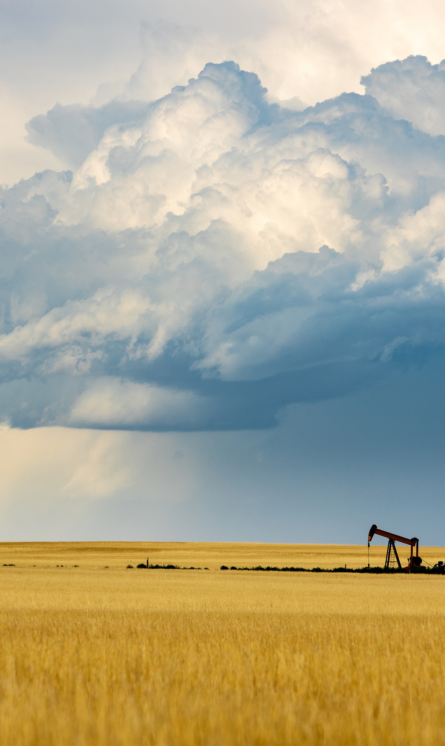
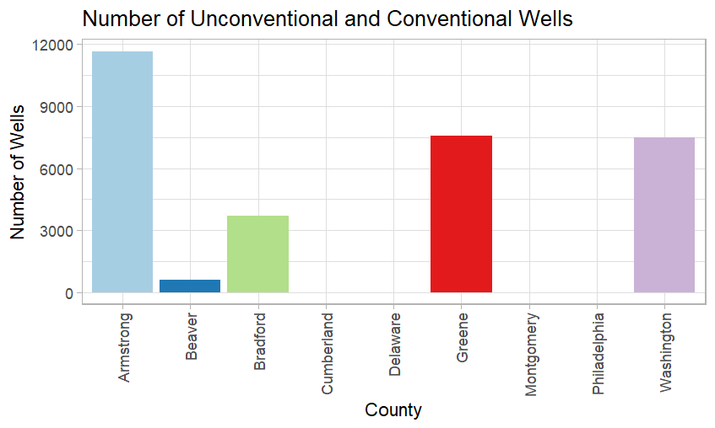
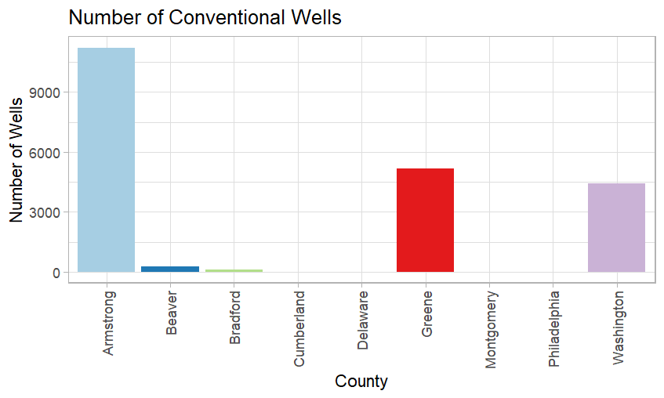
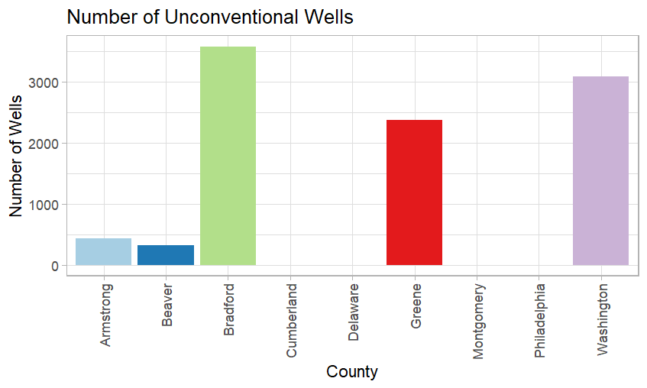
Wells

Slide 4
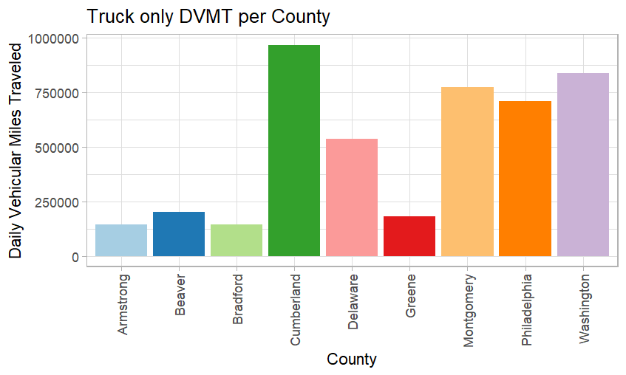
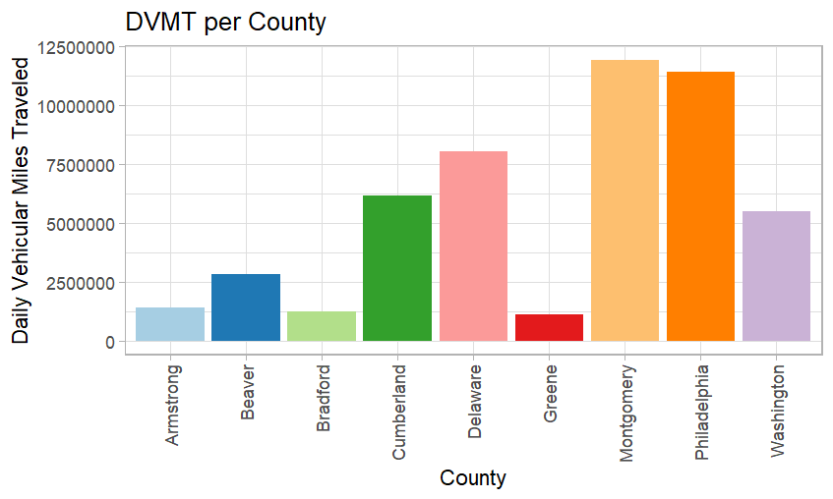
Daily Vehicular miles traveled

Slide 5
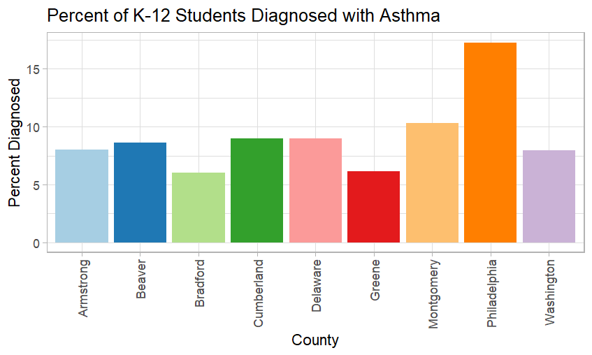
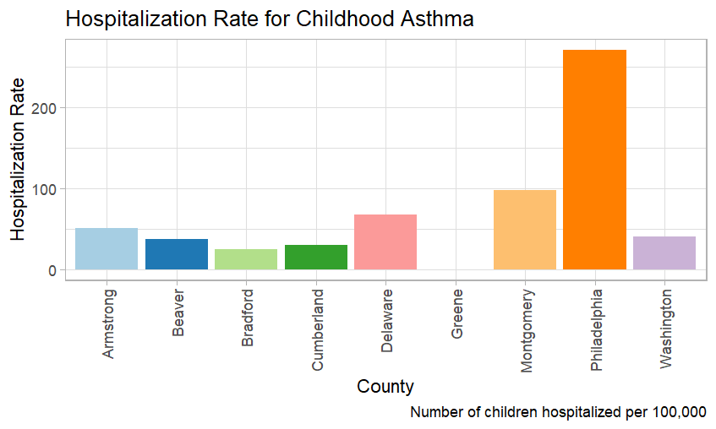
ASthma statistics
*Greene county data not available

Slide 6

Implications for stakeholders
Oil and Gas Stakeholders:
Care about company image and how it may affect consumer behavior
Stock market concerns
Possible lawsuits
Transportation Stakeholders:
Company Image Concerns and how that may affect consumer behavior
Emissions tests and requirements

Slide 7

Ethical, societal, legal implications
Ethical
Adding to long term health problems of the community is unethical
Contributes to global warming which adds to other long-term problems
Societal
Harms society health wise but contributes to the transportation and fuel sectors
Legal
Could open the oil/gas companies to lawsuits
May spark discussion about emissions requirements

Slide 8
Data Sources
PA Gov Asthma School Health Data by County 2023
PA Highway Statistics
Asthma State Data from CDC

